Slide 1

Coffee Analysis
Ariyan Shaikh - team leader
Naoto Shimizu
Alex Tran
Madhulika Sawant
Kyle Drewes

Slide 2


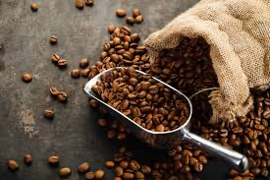
About
• Dataset: Great American Coffee Taste Test 2024
• Participated by 4,042 American coffee drinks
• Each participant was blindly served 4 coffee samples each (A,B,C,D)
• Coffee was rated on bitterness, acidity, and personal preference
• This survey consists of 57 columns of demographic, brewing and spending data
Demographics: age, gender, ethnicity, education level, political affiliation and etc.
Link: https://www.kaggle.com/datasets/ibrahimqasimi/great-american-coffee-taste-test-2024?resource=download

Slide 3

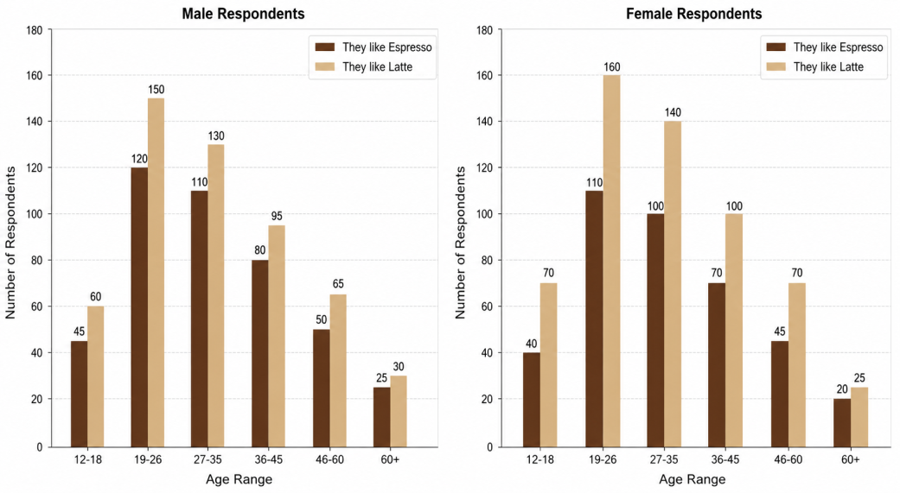
Goal
------------------ Stories ------------------
Load data set – Kyle
Inspect the raw data - Madhulika
Clean Data - Ariyan
Process and analyze - Alex
Visualize - Naoto
• Produce 1 graph that illustrates flavors consumed by females
x = Age Range, y = count of favorite flavor (Pourover, Regular drip coffee, Latte, Cappuccino, Espresso)
• Produce 1 graph that illustrates flavors consumed by males
x = Age Range, y = count of favorite flavor (Pourover, Regular drip coffee, Latte, Cappuccino, Espresso)
Sample use case

Slide 4

Raw Data Over
What did the data look like before any cleaning?
What issues did you identify? (Missing values, wrong data types, duplicates, inconsistent formatting, outliers, etc.)
Show at least one example of a raw data problem you encountered

Slide 5

What steps did your group take to clean the data, and why? What tools and pandas methods did you use? (e.g. dropna, fillna, astype, groupby, merge, etc.) Were there any decisions that required judgement — for example, choosing to drop rows vs. fill missing values? Walk the class through your reasoning
Cleaning & Processing Walkthrough

Slide 6

Finding & Visualizations
What did you discover in the data?
Present your visualizations and explain what each one shows
Did the data confirm your initial hypothesis, surprise you, or raise new questions?

Slide 7

Finding & Visualizations
What would you do differently if you had more time?
What additional data would have been useful?
What was the hardest part of the activity?
What did each team member learn?

Slide 8


Slide 9


Slide 10


Slide 11
Questions ?

